Slide 1
MASTER OF TECHNOLOGY:
PHASE 1 PRESENTATION
[APRIL 2011] (PART 2)
SE18 – Team 2S
Tran Ba Tien
Alvin Chang Parkk Khiong
Maung Tin Kyaw Oo
Roger Koh Ming Jin
Phyo Phyo Lwin
Junaith

Slide 2
Overview
Risk Analysis
Projects plan
Overall project progress
Management problems & solutions

Slide 3
Risk Items
Miscommunication
Personnel shortfalls
Resolution of Technical Issues
Unforeseen Requirement Changes
PM Skill Set

Slide 4
Miscommunication
Risk Localisation
Details
- To produce prototype UI diagrams
- To verify customer's requirements
- Educate the customer on how to accept the software life cycle i.e. It is not easy to change the requirements
- User Manual has to be very clear and precise
- Programmer Manual has to be very clear and precise
- Put more effort in giving user training

Slide 5
Personnel Shortfalls
Risk Insurance
Details
- Identify team member to cover duties/ task
- One of the team member might drop/ defer next semester
- But another member will help/ share his tasks.

Slide 6
Resolution of Technical Issues
Risk Localisation
Details
- Simulate deployment in Lab/ VMWare before actual deployment
- Test the system with real barcode scanner

Slide 7
Unforeseen Requirement Changes
Risk Minimise
Details
- Mitigate the Requirement Changes that may cause instability to the System
- Conduct thorough software testing

Slide 8
PM Skill Set
Risk Transfer
Details
- Already have Technical Lead and Quality Manager
- All of the team member will co-ordinate and discuss if any issue comes out.

Slide 9
Risk Check Box List
No. | Risk Item | Impact |  |  |  |  |  | Likelihood
 |  | 1 | 2 | 3 | 4 | 5 | Total | 1 | 2 | 3 | 4 | 5 | Total
1 | Miscommunication | 1 | 1 | 1 | 1 | 1 | 5 |  |  |  | 1 | 1 | 2
2 | Personnel Shortfalls |  |  | 1 |  |  | 1 |  | 1 | 1 | 1 |  | 3
3 | Resolution of Technical Issues | 1 | 1 | 1 | 1 | 1 | 5 | 1 | 1 |  | 1 | 1 | 4
4 | Unforeseen Requirement Changes | 1 | 1 | 1 |  |  | 3 | 1 |  |  | 1 |  | 2
5 | PM Skill Set |  |  | 1 |  | 1 | 2 |  | 1 |  | 1 |  | 2

Slide 10
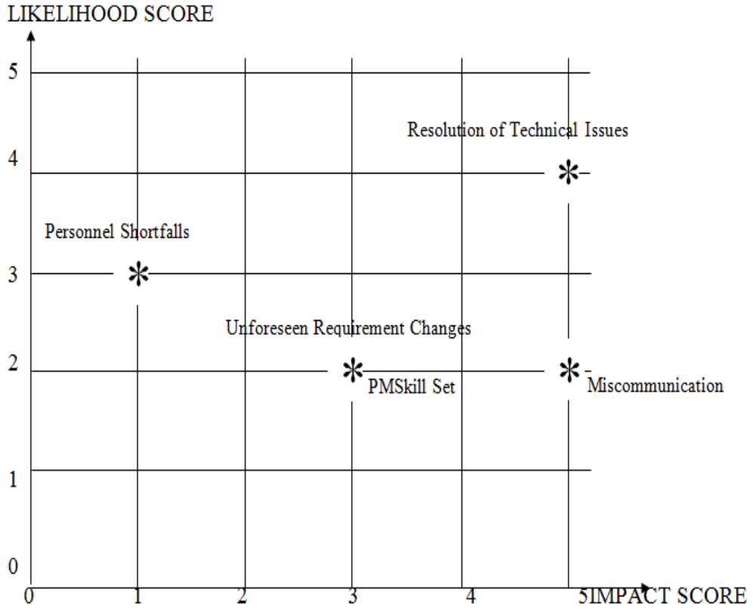
Prioritization of COMS Project Risk

Slide 11
Risk Monitoring Technique
Total score of Risk = 44
Medium size Risk
Top-10 Risk Items Tracking technique
Regular Risk Analysis (Prioritize Risks, Highlight risks in progress reports) every month.

Slide 12
Project Plan
Initial Planning
  Produce Project Plan, Quality Plan
  Set-up filing system
Requirements Identification
  Interview User
  Produce User Requirement Specs, Use Case Model Survey
Requirements Specification
  Write Use Case Realization Reports

Slide 13
Project Planning (2)
Design Modeling
  Prototype User Interface
  Produce High Level Design Specs, Design Model Report
Programming
  Coding & create data structure
Database Migration
  From existing DB to the new DB

Slide 14
Project Planning (3)
System Testing
  Produce System Test Plan
  Conduct testing
User Trial (User Acceptance Test)
  Produce User Guide, Trial Test Plan
  Install and support user testing on-site

Slide 15
Cost Estimate
Efforts: 18.8 man months / 357 man days
Duration: 10.7 months
Justification:
  Understanding Of Requirements
  Experience of Team Members
  Programming Framework
  Development Constraints
  Estimated no. of FPC

Slide 16
Schedule
Initial Planning - 1/2/2011
Requirements Identification - 28/2/2011
Requirements Specification 2/4/2011
Design Modeling 29/4/2011
Programming - 13/7/2011
Database Migration – 20/9/2011
System Testing – 23/10/2011
User Trial - 28/11/2011

Slide 17
Progress So Far
Planning Phase has been completed
URS has been completed
Use Case Model Survey is behind schedule
Reason: must wait for URS & planning documents to be finished

Slide 18
Management Problems
Loss of manpower:
  2 members stopped MTech course.
  1 member took maternity leave.
  Solution: re-assign work to other members, re-analyze project scope.
Behind schedule:
  UC model survey not finished
  →Solution: speed up progress & monitor closely against schedule

Slide 19
Q&A
Thank you

